Slide 1

BCA Ist Semester
PROBLEM SOLVING USING COMPUTER
Course Code: BCAC 0018
Presented by:
Mr.Shivank Chauhan
Dept. Of CEA
GLA University, Mathura

Slide 2
Classification of Computers based on Different Criteria
According to Purpose
  General Purpose Computers
  Special Purpose Computers
According to the basis of data handling
  Analog Computers
  Digital Computers
  Hybrid Computers
According to Size and Capacity
  Supercomputer
  Mainframe Computer
  Minicomputer
  Microcomputer

Slide 3
According to Purpose
General Purpose Computers:
Computers that follow instructions for general requirements such as sales analysis, financial accounting, invoicing, inventory, management information etc. are called General Purpose Computers.
Almost all computers used in offices for commercial, educational and other applications are general purpose computers.

Slide 4
2. Special Purpose Computers:
Computers designed to perform special tasks like scientific applications and research, weather forecasting, space applications, medical diagnostics etc. are called Special Purpose Computers.

Slide 5
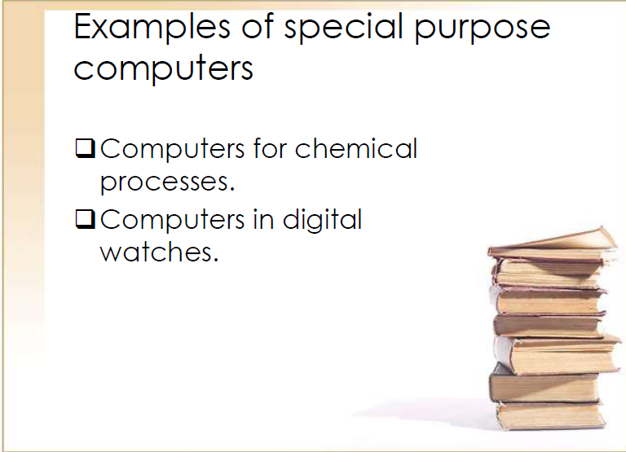

Slide 6
Classification according to Technology

Slide 7
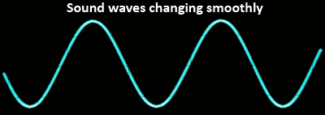
Analog Data
Analog data use values that change very smoothly." Smoothly changing hands of an analog clock.
A good example of this is an analog clock. An analog clock shows the time with a smoothly moving seconds hand. The change is continuous.
Sound is also a good example of analog data. Sound waves change in a very smooth way.
This image shows you an example of a smoothly changing sound wave:

Slide 8
Analog Computer
Analog computer is another kind of a computer that represents data as variable across a continuous range of values.
Analog computers are used for measuring of parameters that vary continuously in real time, such as temperature, pressure and voltage.
Analog computers may be more flexible but generally less precise than digital computers.
Analog computers are in use for some specific applications, like the flight computer in aircraft, ships, submarines, and some appliances in our daily life such as refrigerator, speedometer, etc.

Slide 9
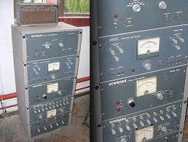
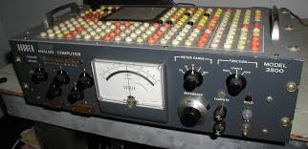
Analog Computers

Slide 10
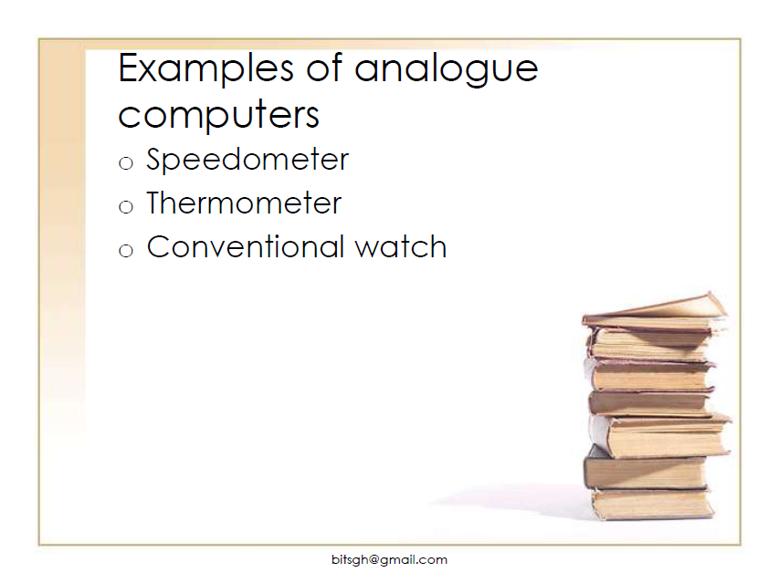

Slide 11
Digital Computer
These computers work on a digital signal.
These signals represent data as a series of discrete values. But, at any given time it can only take on one of a finite number of values.
A computer that performs calculations and logical operations with quantities represented as digits, usually in the binary number system of “0” and “1”,
A binary digit is called a bit. Thus, they represented and store the information in the groups of bits.
Some examples of digital computers are desktop, laptop, calculators, smartphones, etc.

Slide 12
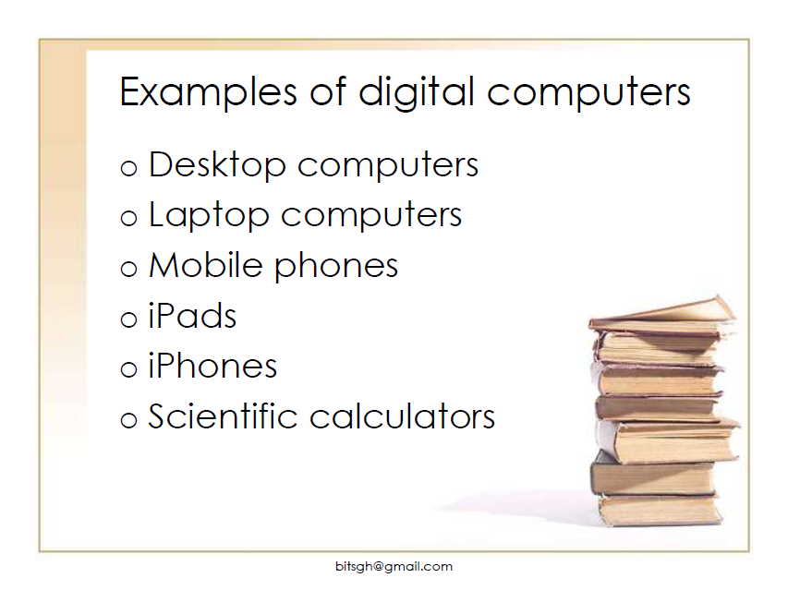

Slide 13
Hybrid Computer
Hybrid computers are computers that exhibit features of analog computers and digital computers.
A computer that processes both analog and digital data, Hybrid computer is a digital computer that accepts analog signals, converts them to digital and processes them in digital form.

Slide 14
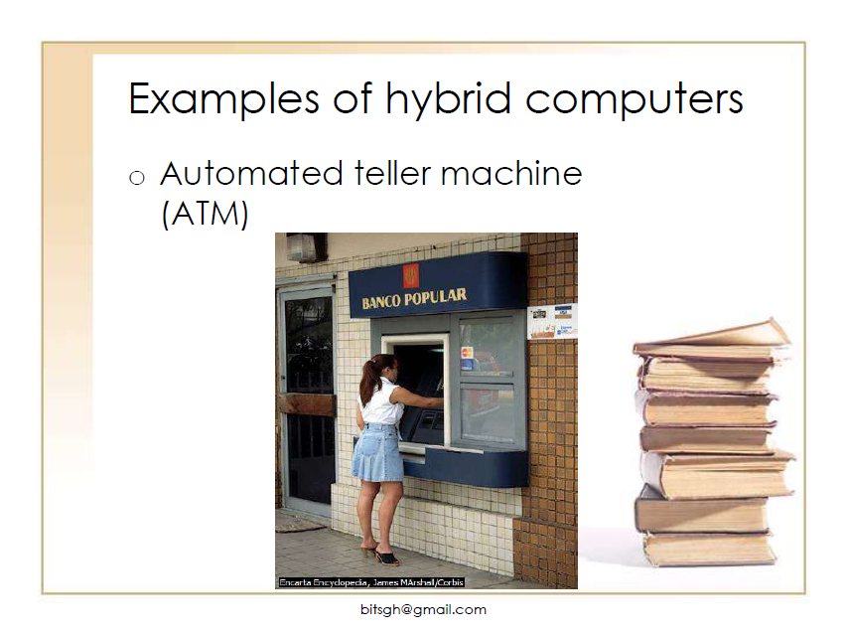

Slide 15
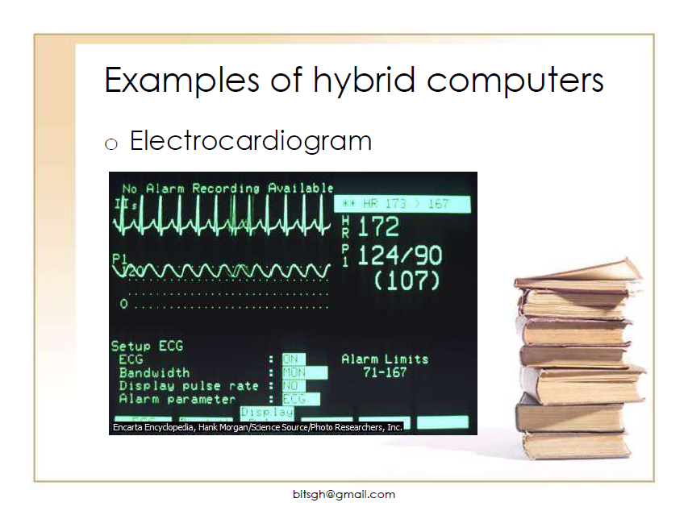

Slide 16
THANK YOU

